Slide 1
PLECS TI C2000 Target Code Generation and Download
Tianxiao Chen

Slide 2
Code generation
Install prerequisite tools
See ‘’TI C2000 Target Installation.pptx””

Slide 3
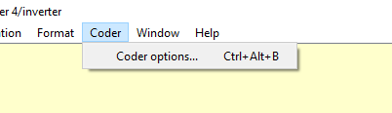
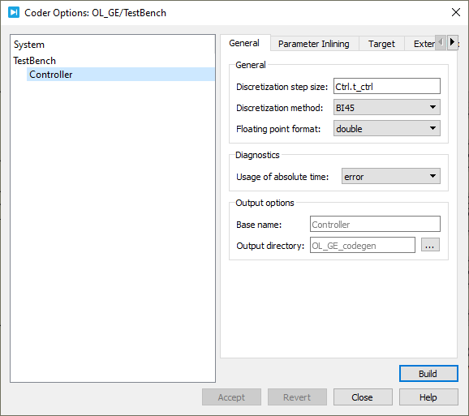

Code generation
Steps
Program download
Connect DSP with PC (USB)
PLECS coder
Specify discretization step size. Generally, it should be the same as sample time step.
(RT Box around 15$μs$)
Select target module

Slide 4
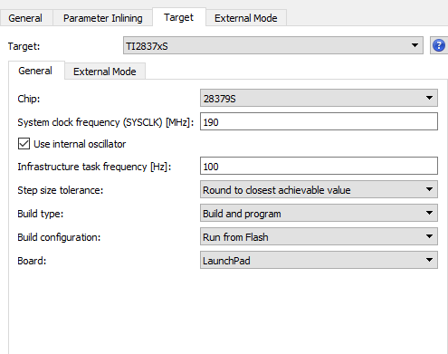
Code generation
Steps
Program download
Select Target
Launchpad target
System clock, max 194 MHz
If select enforce the exact value
Coder may report error, because the frequency in MCU may not be able to achieve the accurate step time. Because the step time may not be the multiples of system clock step time.

Slide 5
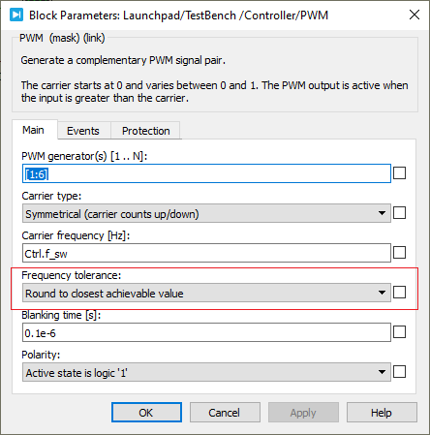
Code generation
Steps
Program download
C2000 PWM module
If select enforce the exact value
Coder may report error, because the frequency in DSP may not achieve the accurate value. E.g. set 20kHz in program, while, in DSP it reaches 19.98kHz, which is acceptable.

Slide 6
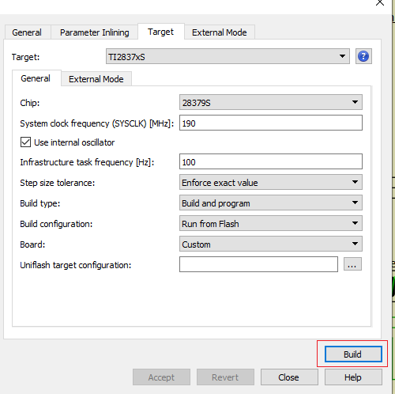
Code generation
Steps
Press ‘Build’ and wait for around 1 min

